Slide 1
First, a question
Can we find the perfect value for a coefficient?

Slide 2
Bayesian Methods
Allow updating an existing probability when additional information is made available
Allows flexibility when integrating different types of “data” to create probabilities
Growing in popularity to solve real problems
Provides a method to “update beliefs”
Argued to be closer to how we think

Slide 3
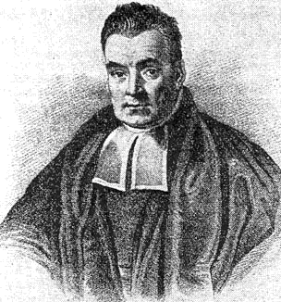
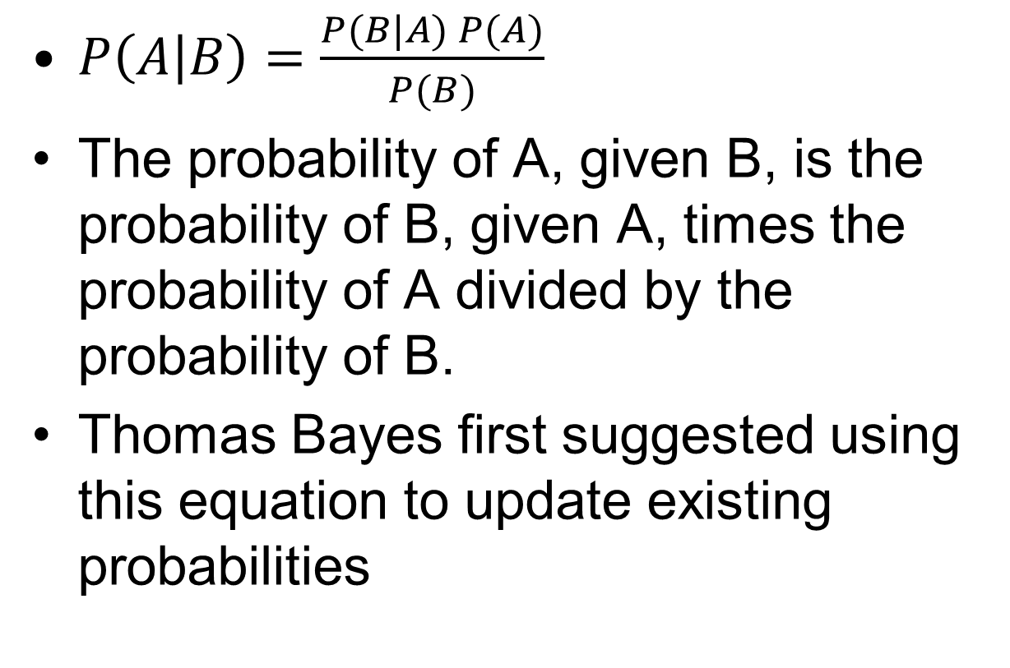
Bayes' Theorem
$P\left(A | B\right)=\frac{P(B|A) P(A)}{P(B)}$
The probability of A, given B, is the probability of B, given A, times the probability of A divided by the probability of B.
Thomas Bayes first suggested using this equation to update existing probabilities

Slide 4
Example: Landslides
P(A|B): Probability of a landslide given that it is raining
  Unknown
P(A): Probability of a landslide
  Number of days with landslides per year / 365
P(B): Probability of rain
  Number of days with rain per year / 365
P(B|A): Probability of rain given a landslide
  Number of days it has rained and had a landslide divided by the number of days with landslides

Slide 5
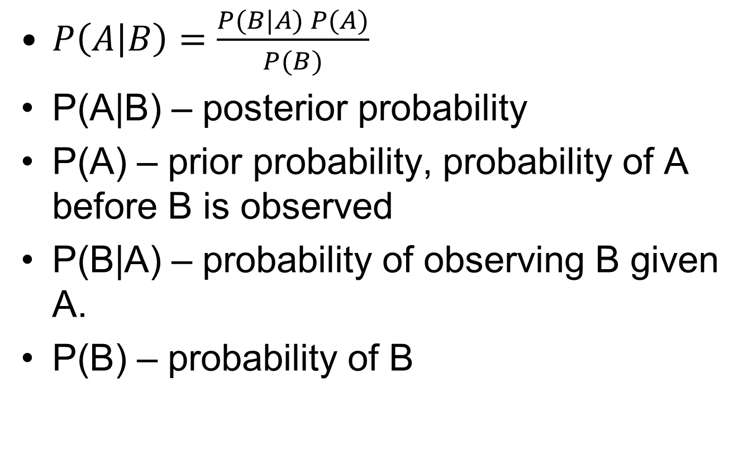
Definition
$P\left(A | B\right)=\frac{P(B|A) P(A)}{P(B)}$
P(A|B) – posterior probability
P(A) – prior probability, probability of A before B is observed
P(B|A) – probability of observing B given A.
P(B) – probability of B

Slide 6
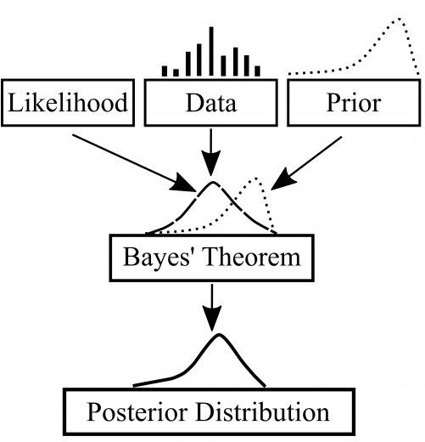
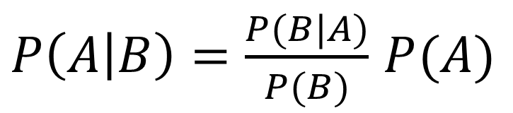
Bayesian Modeling
Likelihood
$P\left(A | B\right)=\frac{P(B|A)}{P(B)}$ $P(A)$
Posterior
Distribution
Prior
Distribution
Data

Slide 7
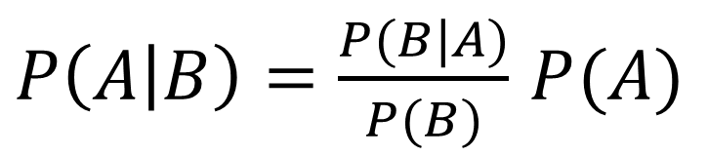
Priors
Informative prior – A prior that is based on data
Uninformative prior – “objective” prior
  Principle of indifference: when in doubt, assign equal probabilities to all outcomes
Likelihood
$P\left(A | B\right)=\frac{P(B|A)}{P(B)}$ $P(A)$
Posterior
Distribution
Prior
Distribution
Data

Slide 8
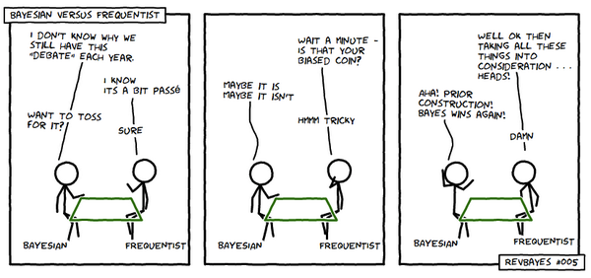
Bayesian vs. Frequentists

Slide 9
Bayesian Continued…
Hierarchical Bayes
  Bayesian equations used to predict coefficients in other equations in levels
Bayesian networks
  Networks of equations/distributions

Slide 10
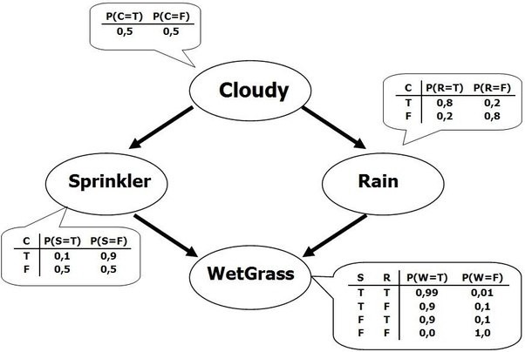
Bayesian Networks
https://towardsdatascience.com/introduction-to-bayesian-networks-81031eeed94e

Slide 11
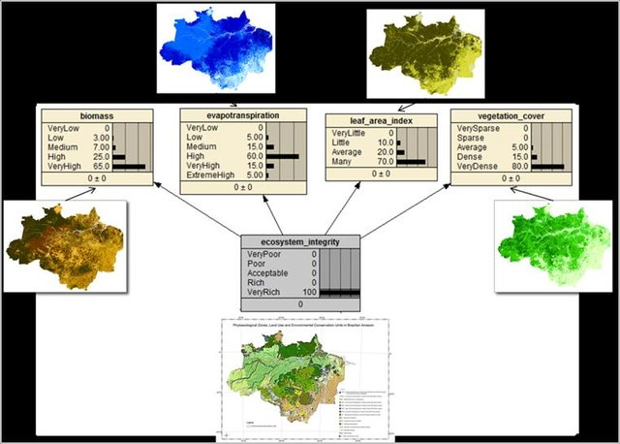
Spatial Bayesian
Effects of land use changes on ecosystem processes, carbon storage and climate change mitigation
Martin Herold, M. García Esteban, Alvaro Ivan Lau Sarmiento, Alvaro Ivan Lau etc.

Slide 12
Tools
WinBUGS – original Bayesian modeling package (worst UI ever!)
GeoBUGS – Spatial Bayes?
Laplace's Demon - a "complete environment for Bayesian inference", their web site also has some very nice introductory material (and some nice merchandise!).
R Packages for Bayes – more on this…

Slide 13
R for Bayes
R2WinBUGS – interface to WinBUGS
JAGS – Designed to work with R
  rjags – interface to JAGS
  coda – library to analyze MCMC results
Stan – faster and larger models
  Rstan – R library
INLA?
Resources
  R and Bayesian Statistics

